Slide 1
JNCIS-ENT
High Availability (HA)

Slide 2
GRES, NSR, NSB and ISSU
2
Graceful Routing Engine Switchover, Nonstop Routing / Bridging and In-Service Software Upgrade

Slide 3
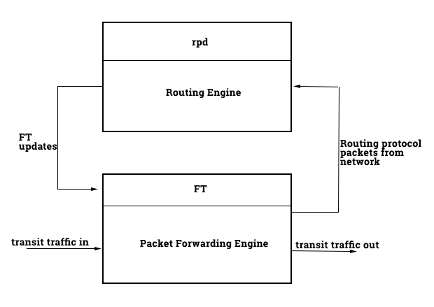
What is GRES
Preserves Interface and kernel information between redundant routing engines
Without this, a failover from one routing engine to a backup routing engine would bounce the interfaces because the PFE will restart
PFE does not restart during a routing engine failover when GRES is configured
Does not preserve control plane information
Although the interfaces will remain up, the rdp will restart, requiring protocol adjacencies to re-established

Slide 4
Redundant Routing Engines
RE0 and RE1 reference the routing engines installed in slot 0 and slot 1
Configuration groups re0 and re1 may be used to set distinct management addresses and hostnames to each RE
Hostname, backup-router and fxp interface configuration may be applied to differentiate each RE
The set system commit synchronize command is required to ensure the RE configurations remain synchronized
Without this command, the commit synchronize command must be entered after each configuration change for the committed configuration to be synchronized to the backup RE
Without GRES enabled, automatic failover to redundant routing engines is not enabled by default
May be enabled with the set chassis redundancy failover command

Slide 5
GRES Configuration
Only a single configuration statement is needed to configure GRES
Once GRES is enabled, the prompt will indicate the role of the currently logged into RE
Some platforms show this at the prompt regardless of GRES being enabled
lab@MX1-re0# set chassis redundancy graceful-switchover
lab@MX1-re0# show chassis
redundancy {
graceful-switchover;
}
lab@MX1-re0# commit
commit complete
{master}
lab@MX1-re0#

Slide 6
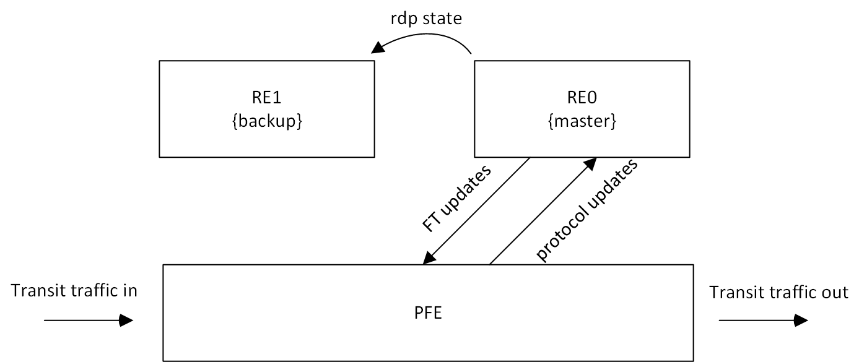
What is NSR
Nonstop active Routing allows a Junos device to failover to a backup routing engine and maintain control plane state
This means routing protocol adjacencies will not need to re-establish after failover, the state is maintained
This is accomplished by running the rpd process on both REs simultaneously
Recall that a failover while only running GRES requires a restart of the rdp
NSR requires the REs run the same version of Junos

Slide 7
NSR Configuration
GRES must be enabled for NSR to function
Also recommended to enable commit synchronization to avoid having to synchronize the REs manually
lab@MX1-re0# set routing-options nonstop-routing
lab@MX1-re0# show routing-options
nonstop-routing;
lab@MX1-re0# show chassis
redundancy {
graceful-switchover;
}
lab@MX1-re0# set system commit synchronize
lab@MX1-re0# commit
re0:
configuration check succeeds
re1:
commit complete
re0:
commit complete
{master}
lab@MX1-re0#

Slide 8

What is NSB
Nonstop Bridging works much like NSR though preserves L2 protocol information during an RE switchover, rather than L3 protocol information
Layer 2 protocols supported include:
Spanning Tree protocol (STP)
Rapid Spanning Tree Protocol (RSTP)
Multiple Spanning tree Protocol (MSTP)
VLAN Spanning Tree Protocol (VSTP)
Like how NSR runs the rpd process on a backup RE, NSB runs the l2cpd process on the backup RE

Slide 9
NSB Configuration
NSB requires that GRES be enabled
lab@EX1# set chassis redundancy graceful-switchover
lab@EX1# show chassis
redundancy {
graceful-switchover;
}
lab@EX1# set protocols layer2-control nonstop-bridging
lab@EX1# commit
commit complete
{master:0}
lab@EX1-re0#

Slide 10
Performing a Unified ISSU
In-service software upgrade allows for Junos software to be upgraded on a redundant RE device with no interruption to the control plane
Requires GRES and NSR to be enabled for layer 3 protocols and NSB for layer 2
All REs must be running the same version of Junos prior to performing the ISSU
{master}
lab@MX1-re0> request system software in-service-upgrade

